Slide 1
Loma Rica Foothill Lions
NEW MEMBER ORIENTATION

Slide 2
Since 1917, Lions have served the world's population through hard work and commitment to make a difference in the lives of people everywhere.
With 1.4 million members
serving in 46,000 clubs in
207 countries and geographical areas,
Lions Clubs International
is the
world's largest service club.
Lions are recognized worldwide for their service to the blind and visually impaired.

Slide 3
LIONISM
Lions Clubs are non-political and non-sectarian
Lions Clubs are composed of business professionals and community minded individuals
Membership is by invitation only
Loma Rica Foothill Lions Orientation 2016/2017

Slide 4
Why Join the Lions? Just a few reasons…
The opportunity to make a difference - as an individual you can have a limited impact, but as part of a group, you can achieve so much more - in your community, your country, your world.
Friendship. In an increasingly complex world, Lions provides one of the easiest ways to meet people in your area. Especially when you live out in the boonies!
Fun. A lot of fun. Each meeting is fun. The club projects are fun. Social activities are fun. And the service is fun.
4. Happy hour!

Slide 5
Benefits of Being A Lion Member
Personal Improvement
Networking
LCIF (Lions Clubs International Foundation)
Club Structure
Leadership Development
Marketing Support
Liability Insurance (1 Million)
Loma Rica Foothill Lions Orientation 2015/2016

Slide 6
Lions Organization Levels
Lions Clubs International
California Multiple District 4
District 4-C1
South Butte Region
East Zone
Loma Rica Foothill Lions Club

Slide 7
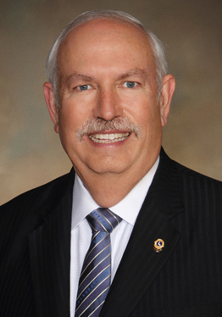
Lions International
100th President
(2016-2017)
Robert “Bob” E. Corlew of Milton, Tennessee
Loma Rica Foothill Lions Orientation 2015/2016

Slide 8
4-C1 District Governor
4-C1 District Governor
Lion Jamie Hart
2016-2017
Willows Lions Club
Loma Rica Foothill Lions Orientation 2016/2017

Slide 9
2015/2016 Officers South Butte Region Level Chair: Lion Bill Paden Zone Level Chair: Lion Someone Foothill Lions Club President: Lion Kim Hall

Slide 10
The Foothill Lions Club of Loma Rica
was chartered on September 3rd, 1983
OUR MAJOR FUNDRAISERS:
Wild Hog Glory Daze
Car Show
Chili Cook Off
White Cane Days
Crab Feeds
Cow Pasture Golf
Loma Rica Foothill Lions Orientation 2016/2017

Slide 11
Club Organizational Chart
ASSEMBLY OF CLUB MEMBERS
BOARD OF DIRECTORS
Executes business of the club, under policies established by the club membership
PRESIDENT
Chief Executive Officer Chairman of Board
Presides at all Meetings
SECRETARY
TREASURER
MEMBERSHIP
1ST VICE PRES.
2ND VICE PRES.
3RD VICE PRES.
Loma Rica Foothill Lions Orientation 2015/2016

Slide 12
Club Officers are elected in March to serve the following Lion Year (July through June):
President……………. To Lead Club
1st VP…………………. To conduct two Club Board and General Meetings; Program Chairperson
2nd VP………………… Club Leadership Chairperson
3rd VP…………………. Club Orientation Officer
Secretary……………. Should hold office only 1 year
Treasurer……………. Have two accounts, admin and community
Membership………… Orientation of new members/recruitment
Tail Twister………….. Introduction of members at meetings
Lion Tamer………….. In charge of club equipment and placement
2nd Year Directors….. Club Retention
1st Year Directors…… Club Guidance
Notes:
Listed on the back of the bulletin

Slide 13
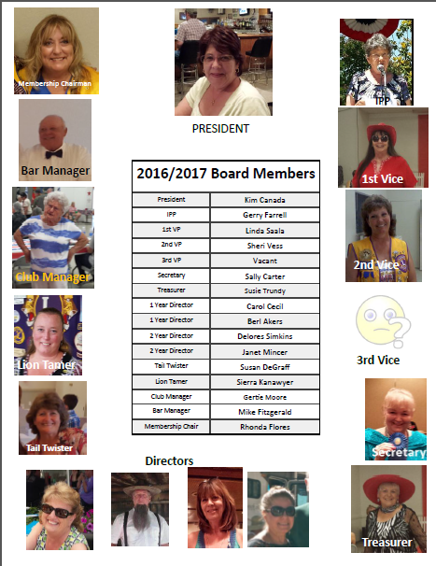
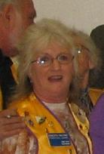
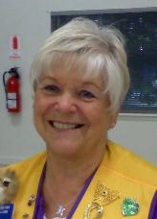
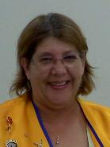
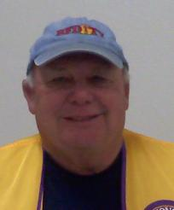
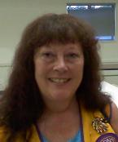
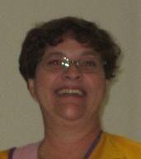
Board Members
2016/2017
Immediate
Past
President
Immediate
Past
President
First Vice
First Vice
Bar Manager
Bar Manager
Secretary
Secretary
Membership
Chairman
Membership
Chairman
Club Manager
Tail Twister
Club Manager
Tail Twister

Slide 14
Foothill Lions Club
Dinner Meetings:
1st and 3rd Thursday of each month at 7PM
Board Meetings:
3rd Thursday of each month at 6PM
Loma Rica Foothill Lions Orientation 2016/2017
Notes:
Everybody is welcome to the board meetings. If you and your sponsor attend a board meeting, visit another club, participate in a club project, attend a zone region or district meeting and bring a guest to a club meeting you will have earned a proud lion and proud sponsor awards. (6 months)

Slide 15
Foothill Lions Club
Tail Twisting
Small “fines” of $.25 to $1 are accessed for members who interrupt the meetings, talk out of turn or just generally irritate the tail twister
Dinner
The delicious dinners served at our Dinner Meeting are brought to us by the Loma Rica Lioness.
Loma Rica Foothill Lions Orientation 2016/2017
Notes:
At the dinner meetings

Slide 16
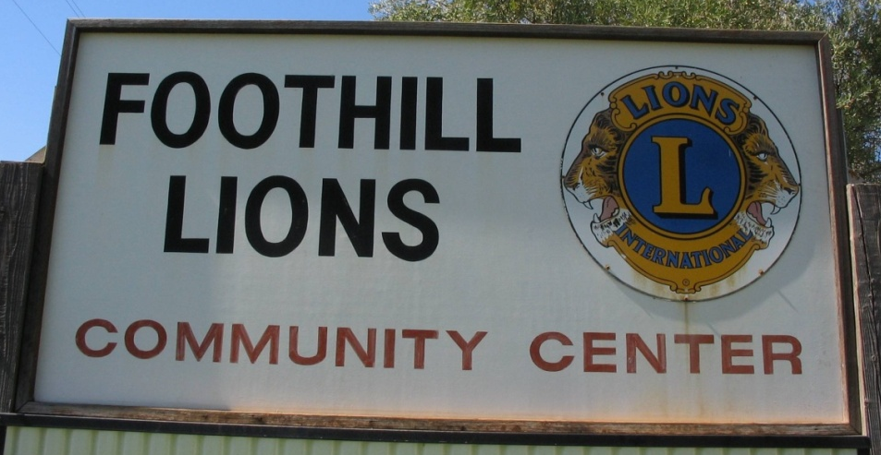
Foothill Lions Club
The Loma Rica Foothill Lions are one of a very few clubs that have their own clubhouse.
2
Loma Rica Foothill Lions Orientation 2015/2016
Notes:
Built and paid for by the charter members and the Lioness club

Slide 17
Dues
Dues are $60* per year.
$30* due January 1st
and
$ 30 due July 1st
of each year.
*subject to change
All dues are sent to “Big Lions”
Loma Rica Foothill Lions Orientation 2016/2017
Notes:
The initial $$ pay for dues, the vest and the name tag. We might have 2 dollars left over.for

Slide 18
THE BUDGET
The cost just to keep our club open is about $55,000 per year.
There are two main accounts: Admin and Community
The community account is funded by community fundraisers. The profits from these activities can only be spent on or for the community.
The money in the Admin Account is funded by profits from the bar and “Lions Only” events. Admin funds are used to pay our club bills.
Notes:
Let Berl have a say. Supported by the bar Have a drink after work!

Slide 19
$38,605.00 directly donated back into our community.*
Vision screening, exams, and eye glasses
Salvation Army (Serving Thanksgiving meals)
Loma Rica Church (Needy Seniors)
Loma Rica Church Turkey Drive
Yuba-Sutter Veterans Parade
Canine Companions f/ Independence (CCI)
American Legion Post 807
Eyeglass Recycling
Yuba-Sutter Foster Parents
Yuba-Sutter Toy Run
Highway Cleanup Project
Lions Christmas Food and Toy baskets
Annual Veterans Day Celebration/Dinner
Local Grange
Fire Victim Support (As needed)
Family Medical Emergency Support (As needed)
Love Lights A Tree Cancer Center
Blue Star Moms (Items for our Soldiers)
These are *Youth Specific Programs*
Student Speaker Program (High School)
Peace Poster Contest (Middle School)
Flag Day Education (Loma Rica/Foothill/Cordua/Browns Valley)
Dobbins School Fall Festival
Boy Scouts
New Playground Equipment
Lions All Star Football Sponsorship
Shady Creek Youth Camp
North Yuba Little League Baseball Donations
4-H
MHS Grad Night
Scholarships and Citizen Awards
CAST for Kids (Special Needs/Disabled)
Christmas/Santa at Spring Valley School
Community East Egg Hunt/Party
Foothill Lions at large in the community
$38,605.00 directly donated back into our community.*
Vision screening, exams, and eye glasses
Salvation Army (Serving Thanksgiving meals)
Loma Rica Church (Needy Seniors)
Loma Rica Church Turkey Drive
Yuba-Sutter Veterans Parade
Canine Companions f/ Independence (CCI)
American Legion Post 807
Eyeglass Recycling
Yuba-Sutter Foster Parents
Yuba-Sutter Toy Run
Highway Cleanup Project
Lions Christmas Food and Toy baskets
Annual Veterans Day Celebration/Dinner
Local Grange
Fire Victim Support (As needed)
Family Medical Emergency Support (As needed)
Love Lights A Tree Cancer Center
Blue Star Moms (Items for our Soldiers)
These are *Youth Specific Programs*
Student Speaker Program (High School)
Peace Poster Contest (Middle School)
Flag Day Education (Loma Rica/Foothill/Cordua/Browns Valley)
Dobbins School Fall Festival
Boy Scouts
New Playground Equipment
Lions All Star Football Sponsorship
Shady Creek Youth Camp
North Yuba Little League Baseball Donations
4-H
MHS Grad Night
Scholarships and Citizen Awards
CAST for Kids (Special Needs/Disabled)
Christmas/Santa at Spring Valley School
Community East Egg Hunt/Party
Halloween Trick-or-Treat Street
Some of the Community services we
Foothill Intermediate School
ROTC of Marysville & Lindhurst High
Local Scout Troops
Shady Creek Outdoor School
Local 4-H
$38,605.00 directly donated back into our community.*
Vision screening, exams, and eye glasses
Salvation Army (Serving Thanksgiving meals)
Loma Rica Church (Needy Seniors)
Loma Rica Church Turkey Drive
Yuba-Sutter Veterans Parade
Canine Companions for Independence (CCI)
American Legion Post 807
Eyeglass Recycling
Yuba-Sutter Foster Parents
Yuba-Sutter Toy Run
Highway Cleanup Project
Lions Christmas Food and Toy baskets
Annual Veterans Day Celebration/Dinner
Local Grange
Fire Victim Support (As needed)
Family Medical Emergency Support (As needed)
Love Lights A Tree Cancer Center
Blue Star Moms (Items for our Soldiers)
These are *Youth Specific Programs*
Student Speaker Program (High School)
Peace Poster Contest (Middle School)
Flag Day Education (Loma Rica/Foothill/Cordua/Browns Valley)
Dobbins School Fall Festival
Boy Scouts
New Playground Equipment
Lions All Star Football Sponsorship
Shady Creek Youth Camp
North Yuba Little League Baseball Donations
4-H
MHS Grad Night
Scholarships and Citizen Awards
CAST for Kids (Special Needs/Disabled)
Christmas/Santa at Spring Valley School
Community East Egg Hunt/Party
Loma Rica Foothill Lions Orientation 2016/2017
$38,605.00 directly donated back into our community.*
Vision screening, exams, and eye glasses
Salvation Army (Serving Thanksgiving meals)
Loma Rica Church (Needy Seniors)
Loma Rica Church Turkey Drive
Yuba-Sutter Veterans Parade
Canine Companions f/ Independence (CCI)
American Legion Post 807
Eyeglass Recycling
Yuba-Sutter Foster Parents
Yuba-Sutter Toy Run
Highway Cleanup Project
Lions Christmas Food and Toy baskets
Annual Veterans Day Celebration/Dinner
Local Grange
Fire Victim Support (As needed)
Family Medical Emergency Support (As needed)
Love Lights A Tree Cancer Center
Blue Star Moms (Items for our Soldiers)
These are *Youth Specific Programs*
Student Speaker Program (High School)
Peace Poster Contest (Middle School)
Flag Day Education (Loma Rica/Foothill/Cordua/Browns Valley)
Dobbins School Fall Festival
Boy Scouts
New Playground Equipment
Lions All Star Football Sponsorship
Shady Creek Youth Camp
North Yuba Little League Baseball Donations
4-H
MHS Grad Night
Scholarships and Citizen Awards
CAST for Kids (Special Needs/Disabled)
Christmas/Santa at Spring Valley School
Community East Egg Hunt/Party
Notes:
There are more as needed…

Slide 20
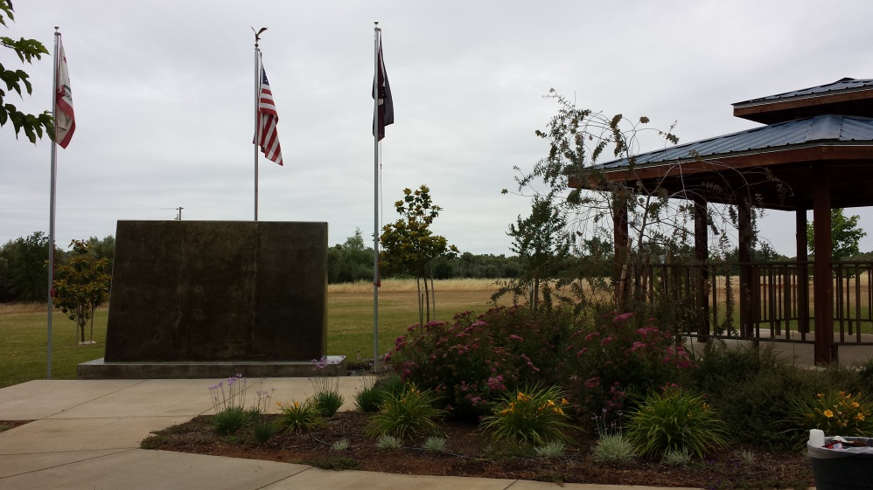
Here are some of the perks of being a FOOTHILL lion:
Hall rental at a discounted rate. Rental includes use of the grounds, kitchen and barbeque area. Currently Lion Debbie and Lion Gertie are in charge of the calendar. Book early!
You can borrow chairs for your next big event. Just be sure to check with the Club Manager and the Lion Tamer and sign out and back in all the equipment you borrow.
Ice for all your chilled beverage needs.
Notes:
Just a side note…please let your friends know that our facility is a beautiful spot for most events. Our rental rate is less than half the average rate of wedding venues in the area and you get full use of the kitchen!

Slide 21
Volunteering
The quickest and easiest way to become an active member is to volunteer.
Put up your hand at the meeting when the president announces we need some help on a project or fundraiser.
Get out there and help!
If you don’t have the time to volunteer don’t worry, you can always stimulate the admin account by having a few toddies at the bar.
And remember, ask not what the club can do for you, ask what you can do for the club.
Notes:
Cliques?

Slide 22
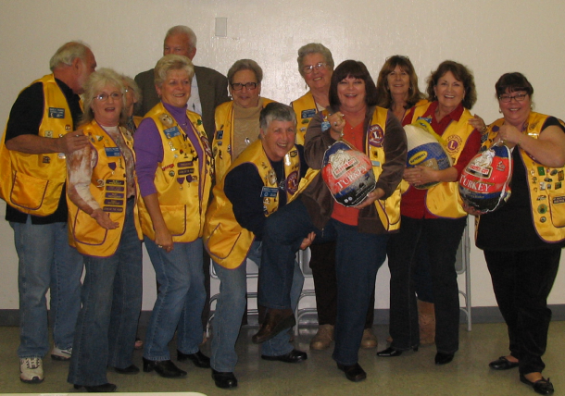
OFFICIAL COLORS
PURPLE
Stands for loyalty to friends, and for integrity of mind and heart.
GOLD
Symbolizes sincerity of purpose, liberality in judgment, purity of life, and generosity in mind, heart and purse to those in need.
Loma Rica Foothill Lions Orientation 2016/2017

Slide 23
THE EMBLEM
Gold letter “L” on a circular purple field
Two conventionalized lion profiles at either side facing away from the center
The word “Lions” appear on the top
The word “International” on the bottom
The lions face both past and future - proud of the past and confident of the future
Loma Rica Foothill Lions Orientation 2016/2017

Slide 24
Slogan
L
iberty,
I
intelligence,
O
ur
N
ation’s
S
afety
Notes:
Slogan

Slide 25
Official Motto
Today with more than 45,000 clubs in 197 countries, Lions have expanded their focus to help meet the
Our programs are continually changing to meet new needs, but our mission has never wavered:
"We Serve."

Slide 26
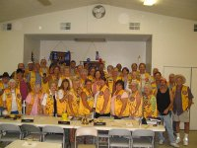
Foothill Lions of Loma Rica
www.foothill-lions.net
“Like” us on
Foothill Lions of Loma Rica on Facebook

Slide 27
The End

